Slide 1
Module 4
Converting Design to Code in JAVA

Slide 2
Java’s History
James Gosling and Sun Microsystems, 1992
Initially “Oak”
Java, May 20, 1995
Aimed to develop platform independent language
To be used in consumer electronic devices
HotJava
The first Java-enabled Web browser

Slide 3
Why Java?
Enables Users
To develop and deploy applications on the Internet
For servers, desktop computers, hand- held devices
Java is a general purpose programming language.
Java is the Internet programming language.

Slide 4
Java, Web, and Beyond
Java can be used to develop Web applications.
Java Applets
Java Servlets and JavaServer Pages
Java can also be used to develop applications for hand-held devices such as Palm and cell phones
Why Java is important to the Internet
Java applets and applications
Security – no virus infection
Portability- portable code

Slide 5
Java’s Magic : The Byte-Code
Java is compiled as well as interpreted language
Highly optimized set of instructions - executed by JVM
Provides portability- need only JVM to execute
Provides Security- all control of JVM
Compiled
Interpreted
Source Code
ByteCode
Output
Java Compiler
JVM

Slide 6
Characteristic of Java
Java Is Simple
Java Is Object-Oriented
Java Is Distributed
Java Is Interpreted
Java Is Robust
Java Is Secure
Java Is Architecture-Neutral
Java Is Portable
Java's Performance
Java Is Multithreaded
Java Is Dynamic

Slide 7
Characteristic of Java
Java Is Simple
Java Is Object-Oriented
Java Is Distributed
Java Is Interpreted
Java Is Robust
Java Is Secure
Java Is Architecture-Neutral
Java Is Portable
Java's Performance
Java Is Multithreaded
Java Is Dynamic
Java is partially modeled on C++, but greatly simplified and improved. Some people refer to Java as "C++--" because it is like C++ but with more functionality and fewer negative aspects.

Slide 8
Characteristic of Java
Java Is Simple
Java Is Object-Oriented
Java Is Distributed
Java Is Interpreted
Java Is Robust
Java Is Secure
Java Is Architecture-Neutral
Java Is Portable
Java's Performance
Java Is Multithreaded
Java Is Dynamic
Java is inherently object-oriented. Although many object-oriented languages began strictly as procedural languages, Java was designed from the start to be object-oriented. Object-oriented programming (OOP) is a popular programming approach that is replacing traditional procedural programming techniques.
One of the central issues in software development is how to reuse code. Object-oriented programming provides great flexibility, modularity, clarity, and reusability through encapsulation, inheritance, and polymorphism.

Slide 9
Characteristic of Java
Java Is Simple
Java Is Object-Oriented
Java Is Distributed
Java Is Interpreted
Java Is Robust
Java Is Secure
Java Is Architecture-Neutral
Java Is Portable
Java's Performance
Java Is Multithreaded
Java Is Dynamic
Distributed computing involves several computers working together on a network. Java is designed to make distributed computing (e.g. Web Services) easy. Since networking capability is inherently integrated into Java, writing network programs is like sending and receiving data to and from a file.

Slide 10
Characteristic of Java
Java Is Simple
Java Is Object-Oriented
Java Is Distributed
Java Is Interpreted
Java Is Robust
Java Is Secure
Java Is Architecture-Neutral
Java Is Portable
Java's Performance
Java Is Multithreaded
Java Is Dynamic
You need an interpreter to run Java programs. The programs are compiled into the Java Virtual Machine code called bytecode. The bytecode is machine-independent and can run on any machine that has a Java interpreter, which is part of the Java Virtual Machine (JVM).

Slide 11
Characteristic of Java
Java Is Simple
Java Is Object-Oriented
Java Is Distributed
Java Is Interpreted
Java Is Robust
Java Is Secure
Java Is Architecture-Neutral
Java Is Portable
Java's Performance
Java Is Multithreaded
Java Is Dynamic
Java compilers can detect many problems that would first show up at execution time in other languages.
Java has eliminated certain types of error-prone programming constructs found in other languages.
Java has a runtime exception-handling feature to provide programming support for robustness.

Slide 12
Characteristic of Java
Java Is Simple
Java Is Object-Oriented
Java Is Distributed
Java Is Interpreted
Java Is Robust
Java Is Secure
Java Is Architecture-Neutral
Java Is Portable
Java's Performance
Java Is Multithreaded
Java Is Dynamic
Java implements several security mechanisms to protect your system against harm caused by stray programs.

Slide 13
Characteristic of Java
Java Is Simple
Java Is Object-Oriented
Java Is Distributed
Java Is Interpreted
Java Is Robust
Java Is Secure
Java Is Architecture-Neutral
Java Is Portable
Java's Performance
Java Is Multithreaded
Java Is Dynamic
Write once, run anywhere
With a Java Virtual Machine (JVM), you can write one program that will run on any platform.

Slide 14
Characteristic of Java
Java Is Simple
Java Is Object-Oriented
Java Is Distributed
Java Is Interpreted
Java Is Robust
Java Is Secure
Java Is Architecture-Neutral
Java Is Portable
Java's Performance
Java Is Multithreaded
Java Is Dynamic
Because Java is architecture neutral, Java programs are portable. They can be run on any platform without being recompiled.

Slide 15
Characteristic of Java
Java Is Simple
Java Is Object-Oriented
Java Is Distributed
Java Is Interpreted
Java Is Robust
Java Is Secure
Java Is Architecture-Neutral
Java Is Portable
Java's Performance
Java Is Multithreaded
Java Is Dynamic
Because Java is architecture neutral, Java programs are portable (moveable). They can be run on any platform without being recompiled.

Slide 16
Characteristic of Java
Java Is Simple
Java Is Object-Oriented
Java Is Distributed
Java Is Interpreted
Java Is Robust
Java Is Secure
Java Is Architecture-Neutral
Java Is Portable
Java's Performance
Java Is Multithreaded
Java Is Dynamic
Multithread programming is smoothly integrated in Java, whereas in other languages you have to call procedures specific to the operating system to enable multithreading.

Slide 17
Characteristic of Java
Java Is Simple
Java Is Object-Oriented
Java Is Distributed
Java Is Interpreted
Java Is Robust
Java Is Secure
Java Is Architecture-Neutral
Java Is Portable
Java's Performance
Java Is Multithreaded
Java Is Dynamic
Java was designed to adapt to an evolving environment. New code can be loaded on the fly without recompilation. There is no need for developers to create, and for users to install, major new software versions. New features can be incorporated transparently as needed.

Slide 18
JDK Versions
JDK 1.0 (Jan. 1996)
JDK 1.1 (Fab. 1997)
JDK 1.2 (Dec. 1998)
JDK 1.3 (May 2000)
JDK 1.4 (Feb. 2002)
JDK 1.5 (Sep. 2004)
JDK 1.6 (Dec. 2006)
JDK 1.7 (July 2011)
JDK 1.8 (Mar. 2014)
JDK 9 (Sep. 2017)
JDK 10 (Mar. 2018)
JDK 11 (Sep. 2018)
JDK 12 (Mar. 2019)
JDK 13 (Sep. 2019)
JDK 14 (Mar. 2020)
JDK 15 (Sep. 2020)

Slide 19
JDK Editions
Java Standard Edition (J2SE)
J2SE can be used to develop client-side standalone (independant) applications or applets.
Java Enterprise Edition (J2EE)
J2EE can be used to develop server-side applications such as Java servlets and Java ServerPages.
Java Micro Edition (J2ME).
J2ME can be used to develop applications for mobile devices such as cell phones.

Slide 20
Java IDE Tools
Borland JBuilder
NetBeans Open Source by Sun
Sun ONE Studio by Sun MicroSystems
Eclipse Open Source by IBM

Slide 21
Object-Oriented Programming
Computer Programming
Process-Oriented
Languages
Object-Oriented
Languages
What is Happening
Series of linear steps
Code acting on data
Who is being affected
Well defined interfaces
Data controlling access to code

Slide 22
Object-Oriented Programming
Abstraction
Data hiding
Hierarchical classification
Manage complexity by breaking the system into more manageable pieces
Encapsulation
“wrap the data”
Binds code and data
Class, objects, methods
Public and private interfaces

Slide 23
Object-Oriented Programming
Inheritance
Process by which one object acquires the properties of another object
Object need only define those qualities that make it unique within its class
Inherit its general properties from its parent
Different types of inheritance
Class A
Class A
Class A
Class A
Class B
Class B
Class B
Class C
Multiple Inheritance
Single Level
Multi Level

Slide 24
Object-Oriented Programming
Polymorphism
“one interface multiple methods”, many forms
Possible to design a generic interface to a group of related activities
Reduce complexity
Compiler selects the specific action as it applies to each situation

Slide 25
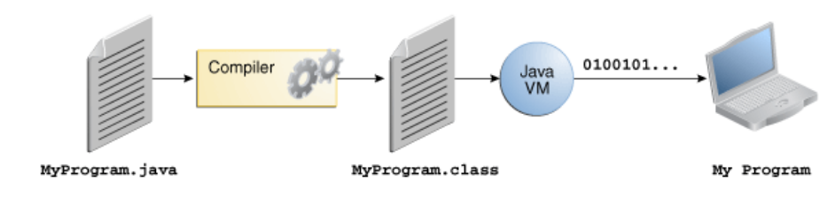
Java Program
javac
java

Slide 26
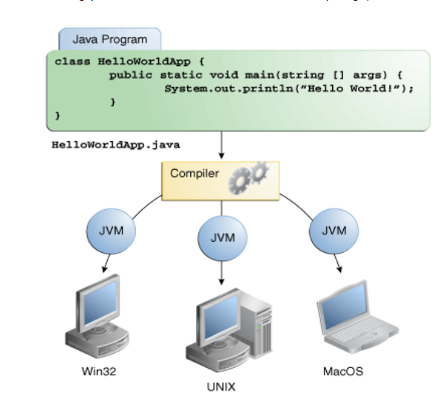
Java Program

Slide 27
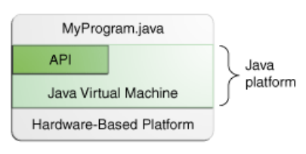
The Java Platform
A platform is the hardware or software environment in which a program runs. For ex. Microsoft Windows, Linux, Solaris OS, and Mac OS.
The Java platform has two components:
The Java Virtual Machine
The Java Application Programming Interface (API)
The API is a large collection of ready-made software components that provide many useful capabilities

Slide 28
"Hello World!" for Microsoft Windows
Checklist
The Java SE Development Kit 8 (JDK 8)
A text editor
Creation of first program
Create a source file
Compile the source file into a .class file
Run the program

Slide 29
A Simple Java Program (welcome.java)
/**
* The HelloWorldApp class implements an application that simply prints "Hello World!" to standard output.
*/
class HelloWorldApp {
public static void main(String[] args) {
System.out.println("Hello World!"); // Display the string.
}
}
> javac Welcome.java
> java HelloWorldApp 1 2 3 4 5

Slide 30
A closer look
Source code comments
Class definition
Main method

Slide 31
Comments
Ignored by the compiler
3 type:
/* text */ 🡪The compiler ignores everything from /* to */
/** documentation */🡪 generally used by Javadoc
// text 🡪 The compiler ignores everything from // to the end of the line.

Slide 32
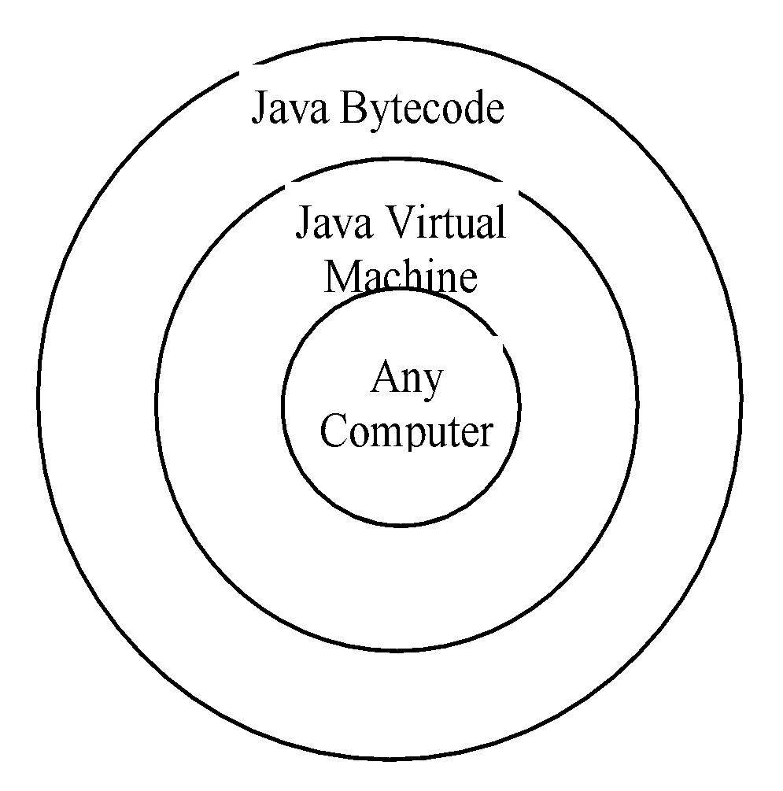
Compiling JAVA Source Code
Compile the welcome program by executing the compiler, javac
C:\> javac welcome.java
The javac compiler creates a file called welcome.class - bytecode version of the class
Use java interpreter , called java to run the program
The bytecode can run on any computer with a Java Virtual Machine
C:\>java welcome

Slide 33
Trace a Program Execution
Enter main method
//This program prints Welcome to Java!
public class Welcome
{
public static void main(String[] args)
{
System.out.println("Welcome to Java!");
}
}

Slide 34
Trace a Program Execution
Execute statement
//This program prints Welcome to Java!
public class Welcome
{
public static void main(String[] args)
{
System.out.println("Welcome to Java!");
}
}

Slide 35
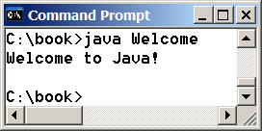
Trace a Program Execution
//This program prints Welcome to Java!
public class Welcome
{
public static void main(String[] args)
{
System.out.println("Welcome to Java!");
}
}
print a message to the console

Slide 36
Anatomy of a Java Program
Comments
Reserved words
Modifiers
Statements
Blocks
Classes
Methods
The main method

Slide 37
Comments
The contents of a comment are ignored by the compiler.
Java supports three styles of comments:
Single-line comment – starts with two slashes(//)
– when the compiler sees //, it ignores all text after // in the same line
Multiline comment – enclosed between /* and */
– when compiler sees /*, it scans for the next */ and ignores any text between /* and */
Documentation comment – use to produce an HTML file.
– enclosed between /** and */

Slide 38
Reserved words
Reserved words or keywords are words that have a specific meaning to the compiler and cannot be used for other purposes in the program.
Example - public, static, void etc.

Slide 39
(Visibility or Access) Modifiers
Java uses certain reserved words called modifiers that specify the properties of the data, methods, and classes and how they can be used.
Examples of modifiers are public and static.
Other modifiers are private, final, abstract, and protected.
public > protected > package (default) > private

Slide 40
Statements
A statement represents an action or a sequence of actions.
The statement System.out.println("Welcome to Java!") in the program is a statement to display the greeting "Welcome to Java!"
Every statement in Java ends with a semicolon (;).

Slide 41
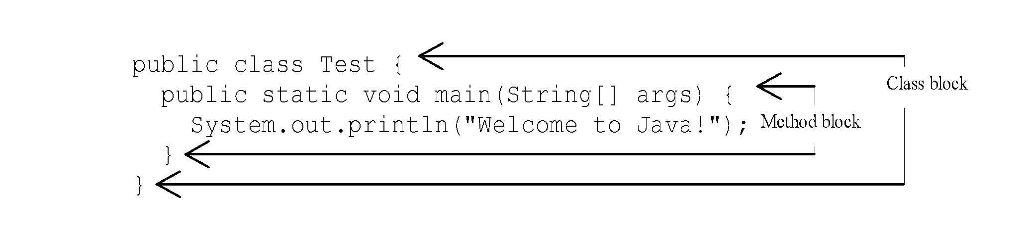
Blocks
A pair of braces in a program forms a block that groups components of a program.

Slide 42
Classes
The class is the essential Java construct.
A class is a template or blueprint for objects.
Keyword class is used to declare a new class.
The entire class definition, including all of its members, will be between the opening curly brace ({) and the closing curly brace (}).

Slide 43
Methods
A collection of statements that performs a sequence of operations and can be reuse with different arguments.
There is no need to write all the statements again and again. Using a single line call statement to execute a collection of statements.

Slide 44
main Method
The main method provides the control of program flow. The Java interpreter executes the application by invoking the main method.
The main method looks like this:
public static void main(String[] args)
{
// Statements;
}

Slide 45
Contd…
All Java applications begin execution by calling main()
public – an access specifier. Public member can be accessed by code outside the class. main() is declared public, since it must be called outside of its class when the program is started.
static – allows main to be called without having to instantiate a particular instance of the class. main() is called by java interpreter before any objects are made.

Slide 46
Contd…
void – simply tells the compiler that main() does not return a value
String args[] – parameter for main() method. It declares an array of instances of the class String that stores character strings. args receives any command line arguments when program is executed.

Slide 47
The Java Keywords
abstract | continue | goto | package | synchronized
assert | default | if | private | this
boolean | do | implements | protected | throw
break | double | import | Public | throws
byte | Else | instanceof | return | transient
case | extends | int | short | try
catch | final | interface | static | void
char | finally | long | strictfp | volatile
class | float | native | super | while
const | for | new | switch

Slide 48
Command Line Arguments
These are the parameters that are supplied to the application program at the time of invoking it for execution.
Public static void main (String args[ ])
Any arguments provided in the command line are passed to the array args.
C:> Java example hello world
Assigned to the araay args as follows:
Args[0] = hello
Args[1] = world

Slide 49
Constants
Refer to fixed values that do not change during the execution of a program.
Integer Constants: sequence of digits
123 037 0X2
Real Constants: numbers containing fractional parts
0.0083 -0.75 435.36
Single character Constants: single character
‘5’ ‘A’ ‘;’
String Constants: sequence of characters
“Hello World” “?+;;;;….#”
Backslash character (Symbolic) Constants: used in output methods
‘\n’ ‘\b’ ‘\t’ ‘\’’ ‘\\”’ ‘\\’

Slide 50
Symbolic Constants
Some constants may appear repeatedly in a number of places in the program.
These constants can be defined as a symbolic name
Make a program:
easily modifiable
More understandable
final type symbolic name = value
ex: final float PI = 3.14159

Slide 51
Variables
An identifier that denotes a storage location used to store a data value.
May take different values at different times during the execution of the program
Naming Conventions: may consists of alphabets, digits, underscore and dollar with following conditions
Must not begin with a digit
Uppercase and Lowercase are distinct.
Should not be a keyword
Space is not allowed

Slide 52
Scope of Variables
Classified into three kinds:
Instance Variables
Created when the objects are instantiated
Take different values for each object
Class Variables
Global to a class
Belong to the entire set of objects that class creates
Only one memory location is created
Local Variables
Used inside methods or inside program blocks.
Blocks are defined between opening brace { and a closing brace }
Visible to program only from the beginning to the end of the block.

Slide 53
Data Types
Data type specify the size and type of values
Java defines eight simple types of data. These can be put into four groups:
Integers
Floating-point numbers
Characters
Boolean

Slide 54
Data Types contd…
Integers
Floating-point
Name | Width(Size) | Range
byte | 8 bits | -128 to 127
short | 16 bits | -32768 to 32767
int | 32 bits | -2147483648 to 2147483647
long | 64 bits | -2⁶⁴⁻¹ to 2⁶⁴⁻¹ -1
Name | Width(Size) | Range
float | 32 bits | 1.4e-045 to 3.4e+038
double | 64 bits | 4.9e-324 to 1.8e+038

Slide 55
Data Types contd…
Characters
Data type used to store character is char.
It requires 16 bits.
Range of a char is 0 to 65536 (no negative char)
Boolean
Used to test a particular condition
It can take only two values: true and false
Uses only 1 bit of storage
All comparison operators return boolean value

Slide 56
Control Statements
Control the flow of execution of the program. This execution order depends on the supplied data values and the conditional logic.
Java contains following types of control statements
Selection statements
Iteration statements
Branching statements

Slide 57
Selection Statements
If statement
This is a control statement to execute a single statement or a block of code, when the given condition is true and if it is false then it skips if block and rest code of program is executed.
Syntax: if(conditional_expression){ <statements>; ...; ...; }
Example: If n%2 evaluates to 0 then the "if" block is executed. Here it evaluates to 0 so if block is executed. Hence "This is even number" is printed on the screen.
int n = 10;
if(n%2 = = 0){
System.out.println("This is even number");
}

Slide 58
Example: If n%2 evaluates to 0 then the "if" block is executed. Here it evaluates to 0 so if block is executed. Hence "This is even number" is printed on the screen.
Selection Statements
If-else Statement
The "if-else" statement is an extension of if statement that provides another option when 'if' statement evaluates to "false" i.e. else block is executed if "if" statement is false.
Syntax: if(conditional_expression){ <statements>; ...; ...; } else{ <statements>; ....; ....; }
Example: If n%2 doesn't evaluate to 0 then else block is executed. Here n%2 evaluates to 1 that is not equal to 0 so else block is executed. So "This is not even number" is printed on the screen.
int n = 11;if(n%2 = = 0){
System.out.println("This is even number");
}
else{
System.out.println("This is not even number");
}

Slide 59
Example: If n%2 evaluates to 0 then the "if" block is executed. Here it evaluates to 0 so if block is executed. Hence "This is even number" is printed on the screen.
Selection Statements
Switch Statement
Example: Here expression "day" in switch statement evaluates to 5 which matches with a case labeled "5" so code in case 5 is executed that results to output "Friday" on the screen. int day = 5;switch (day) { case 1: System.out.println("Monday"); break; case 2: System.out.println("Tuesday"); break; case 3: System.out.println("Wednesday"); break; case 4: System.out.println("Thrusday"); break; case 5: System.out.println("Friday"); break; case 6: System.out.println("Saturday"); break; case 7: System.out.println("Sunday"); break; default: System.out.println("Invalid entry"); break; }
Syntax: switch(control_expression){ case expression 1: <statement>; case expression 2: <statement>; ... ... case expression n: <statement>; default: <statement>; }//end switch

Slide 60
Example: If n%2 evaluates to 0 then the "if" block is executed. Here it evaluates to 0 so if block is executed. Hence "This is even number" is printed on the screen.
Iteration Statements
while loop statements
It executes a block of code or statements till the given condition is true. The expression must be evaluated to a boolean value.
Syntax: while(expression){ <statement>; ...; ...; }
Example: prints values 1 to 10 on the screen.
int i = 1;//print 1 to 10
while (i <= 10){
System.out.println("Num " + i);
i++;
}

Slide 61
Example: If n%2 evaluates to 0 then the "if" block is executed. Here it evaluates to 0 so if block is executed. Hence "This is even number" is printed on the screen.
Iteration Statements
do-while loop statements
First the do block statements are executed then the condition given in while statement is checked. So in this case, even the condition is false in the first attempt, do block of code is executed at least once.
Syntax: do{ <statement>; ...; ...; }while (expression);
Example: prints values 1 to 10 on the screen.
int i = 1;do{
System.out.println("Num: " + i);
i++;
}while(i <= 10);

Slide 62
Example: If n%2 evaluates to 0 then the "if" block is executed. Here it evaluates to 0 so if block is executed. Hence "This is even number" is printed on the screen.
Iteration Statements
for loop statements
Syntax: for (initialization; condition; increment or decrement)
{ <statement>; ...; ...; } initialization: The loop is started with the value specified. condition: It evaluates to either 'true' or 'false'. If it is false then the loop is terminated. increment or decrement: After each iteration, value increments or decrements.
Example: prints values 1 to 10 on the screen.
for (int num = 1; num <= 10; num++)
{ System.out.println("Num: " + num);
}

Slide 63
Example: If n%2 evaluates to 0 then the "if" block is executed. Here it evaluates to 0 so if block is executed. Hence "This is even number" is printed on the screen.
Branching Statements
Break statements
The break statement is a branching statement that contains two forms: labeled and unlabeled. The break statement is used for breaking the execution of a loop (while, do-while and for) . It also terminates the switch statements.
Syntax: break; // breaks the innermost loop or switch statement. break label; // breaks the outermost loop in a series of nested loops.

Slide 64
Example: If n%2 evaluates to 0 then the "if" block is executed. Here it evaluates to 0 so if block is executed. Hence "This is even number" is printed on the screen.
Branching Statements
Using break as form of goto
Break statements
Class Break{
public static void main( String a[]){
boolean t=true;
First:{
second:{
Third:{
System.out.println(“before break);
If(t) break second;
System.out.println(“this won’t execute);
}
System.out.println(“this won’t execute);
}
System.out.println(“this is after second block”);}}}
Using break to exit a loop
Class breakloop
{
public static void main( String a[])
{
for(int i=0;i<100;i++)
{
if(i==10) break;
System.out.println(“i:”+i);
}
System.out.println(“loop complete”);
} }

Slide 65
Example: If n%2 evaluates to 0 then the "if" block is executed. Here it evaluates to 0 so if block is executed. Hence "This is even number" is printed on the screen.
Branching Statements
Continue statements
This is a branching statement that are used in the looping statements (while, do-while and for) to skip the current iteration of the loop and resume the next iteration .
Syntax: continue;
Example:
Class Continue{
public static void main( String a[]){
for(int i=0;i<10;i++){
System.out.println(i+ “”);
if(i%2==0) continue;
System.out.println(“ ”);
}}}

Slide 66
Example: If n%2 evaluates to 0 then the "if" block is executed. Here it evaluates to 0 so if block is executed. Hence "This is even number" is printed on the screen.
Branching Statements
return
return statement can be used to cause execution to branch back to the caller of the method.
Example:
Class Return{
public static void main( String a[]){
boolean t= true; System.out.println(“before the return”);
if(t) return;
System.out.println(“This won’t execute ”);
}}

Slide 67
Thank you !!

